Slide 1
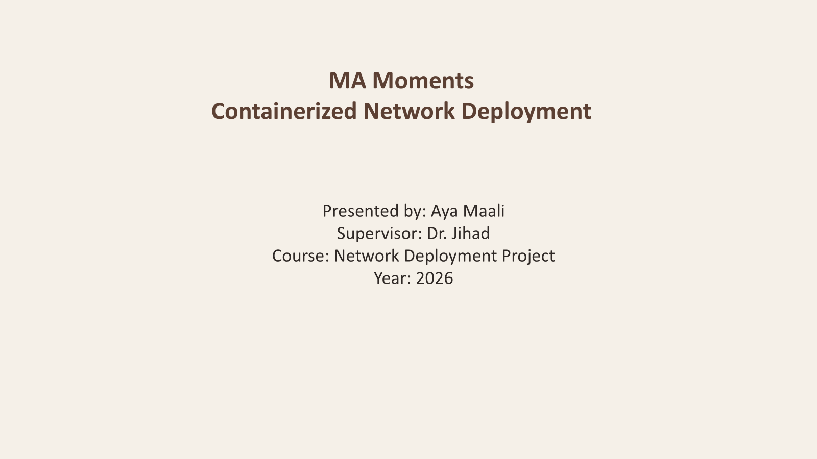

Slide 2
MA Moments
Containerized Network Deployment Docker -> Containerlab -> Proxmox -> zrok
MA Moments

Slide 3
Project Idea
• E-commerce website • Deploy on Ubuntu VM • Public access using zrok
MA Moments

Slide 4
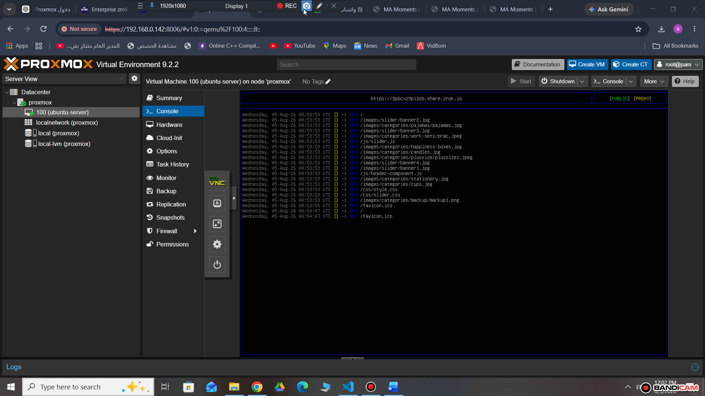
Architecture
Internet ↓ zrok Public URL ↓ Proxmox ↓ Ubuntu Server VM ↓ Docker + Nginx ↓ MA Moments

Slide 5
Implementation
• Build Docker image • topology.clab.yml • Deploy Containerlab • Publish using zrok
MA Moments

Slide 6
Testing
• Local browser test • Public HTTPS access • Verified HTTP requests

Slide 7
Challenges
• YAML syntax • zrok API endpoint • Docker networking • Port mapping
MA Moments

Slide 8
Result
✔ Public URL working ✔ Secure HTTPS ✔ Containerized deployment

Slide 9
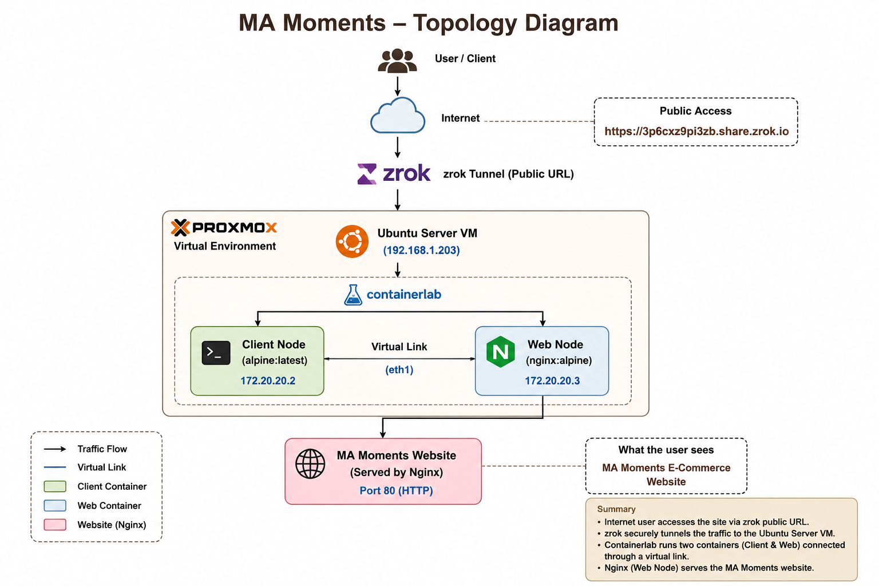
Topology Diagram

Slide 10
Thank You
Questions?
MA Moments

